Slide 1


Welcome to the
2025 Annual Business Meeting
Wednesday, April 22, 2025
12:15 pm – 1:00 pm
Grand Hyatt Buckhead, Atlanta, Georgia

Slide 2

AGENDA
President’s Report – Catherine Lang, PT, PhD, FASNR
Treasurer’s Report – Jason Carmel, MD, PhD
Program Chair Report – Kelsey Baker, PhD
Education Committee Report – Ela Plow, PT, PhD
Membership Engagement Committee Report – Steven Zeiler, MD, PhD
NNR Report – Randy Nudo, PhD
Spring 2025 Election Results – Catherine Lang, PT, PhD, FASNR
Special Thank You – Catherine Lang, PT, PhD, FASNR
Additional Business – Catherine Lang, PT, PhD, FASNR
Adjourn

Slide 3
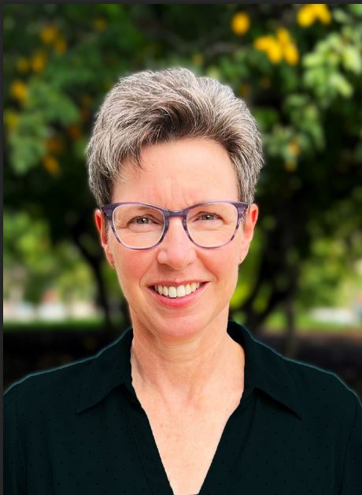
President’s Report
Catherine Lang, PT, PhD, FASNR

Slide 4

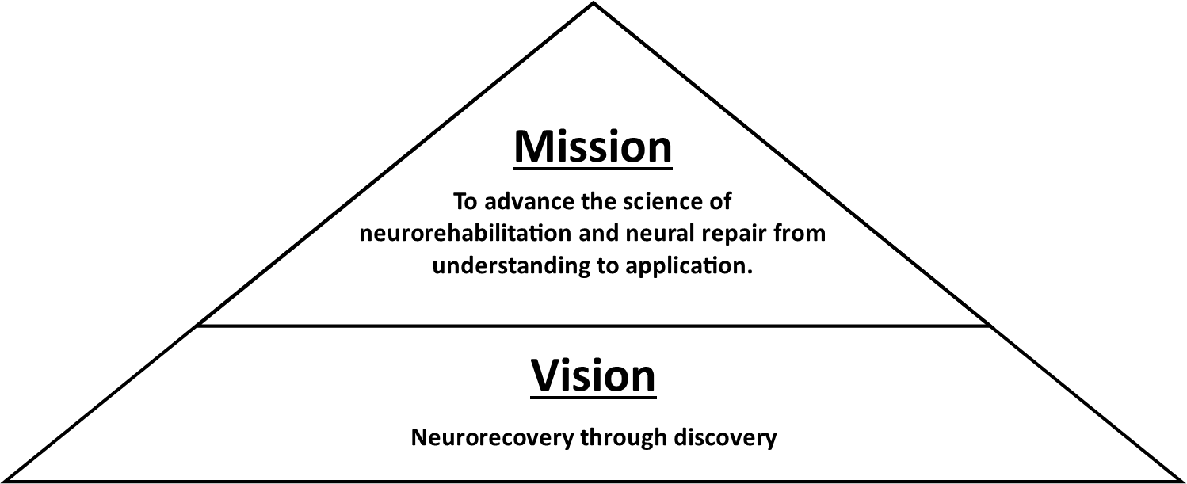
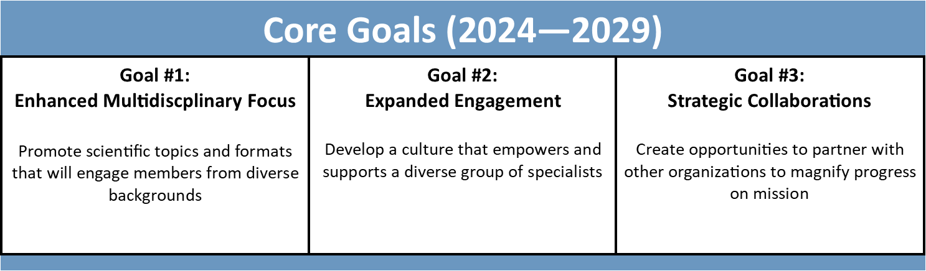
New ASNR Strategic Plan

Slide 5
Core Goal #1: Enhanced Multidisciplinary Focus
Promote scientific topics and formats that will engage members from diverse backgrounds
Strategy 1: Broaden ASNR’s scientific and clinical reach by integrating a wider range of neurorehabilitation conditions, disciplines, and perspectives into its programs and membership.
Strategy 2: Broaden ASNR’s scientific and clinical reach by integrating a wider range of neurorehabilitation conditions, disciplines, and perspectives into its programs and membership.

Slide 6
Core Goal #2: Expanded Engagement
Develop a culture within the society that empowers and supports a diverse membership
Strategy 1: Increase clinical practitioner membership by identifying barriers to retention and engagement, and implementing targeted outreach and engagement strategies
Strategy 2: Build a culture of growth by developing special interest communities that bring in new members and keep current members engaged around different topics, with an emphasis on bringing in trainees across all areas
Strategy 3: Support networking and ensure responsibility and sustainability for DEI efforts
Strategy 4: Improve patient engagement in ASNR

Slide 7
Core Goal #3: Strategic Collaborations
Create opportunities to partner with other organizations to magnify progress on mission
Strategy 1: Expand ASNR’s external visibility at diverse scientific venues and other conferences through careful event selection, strategic planning, and collaboration opportunities

Slide 8
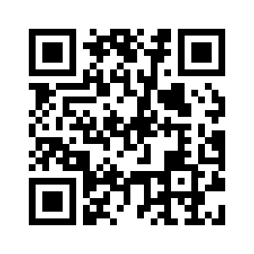
New ASNR Strategic Plan
To view the entire strategic plan, including tactics for achieving each of the core goals and strategies, visit www.asnr.com/strategic-plan or scan the QR code.

Slide 9
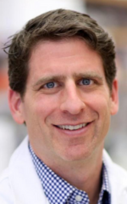
Treasurer’s Report
Jason Carmel, MD, PhD

Slide 10
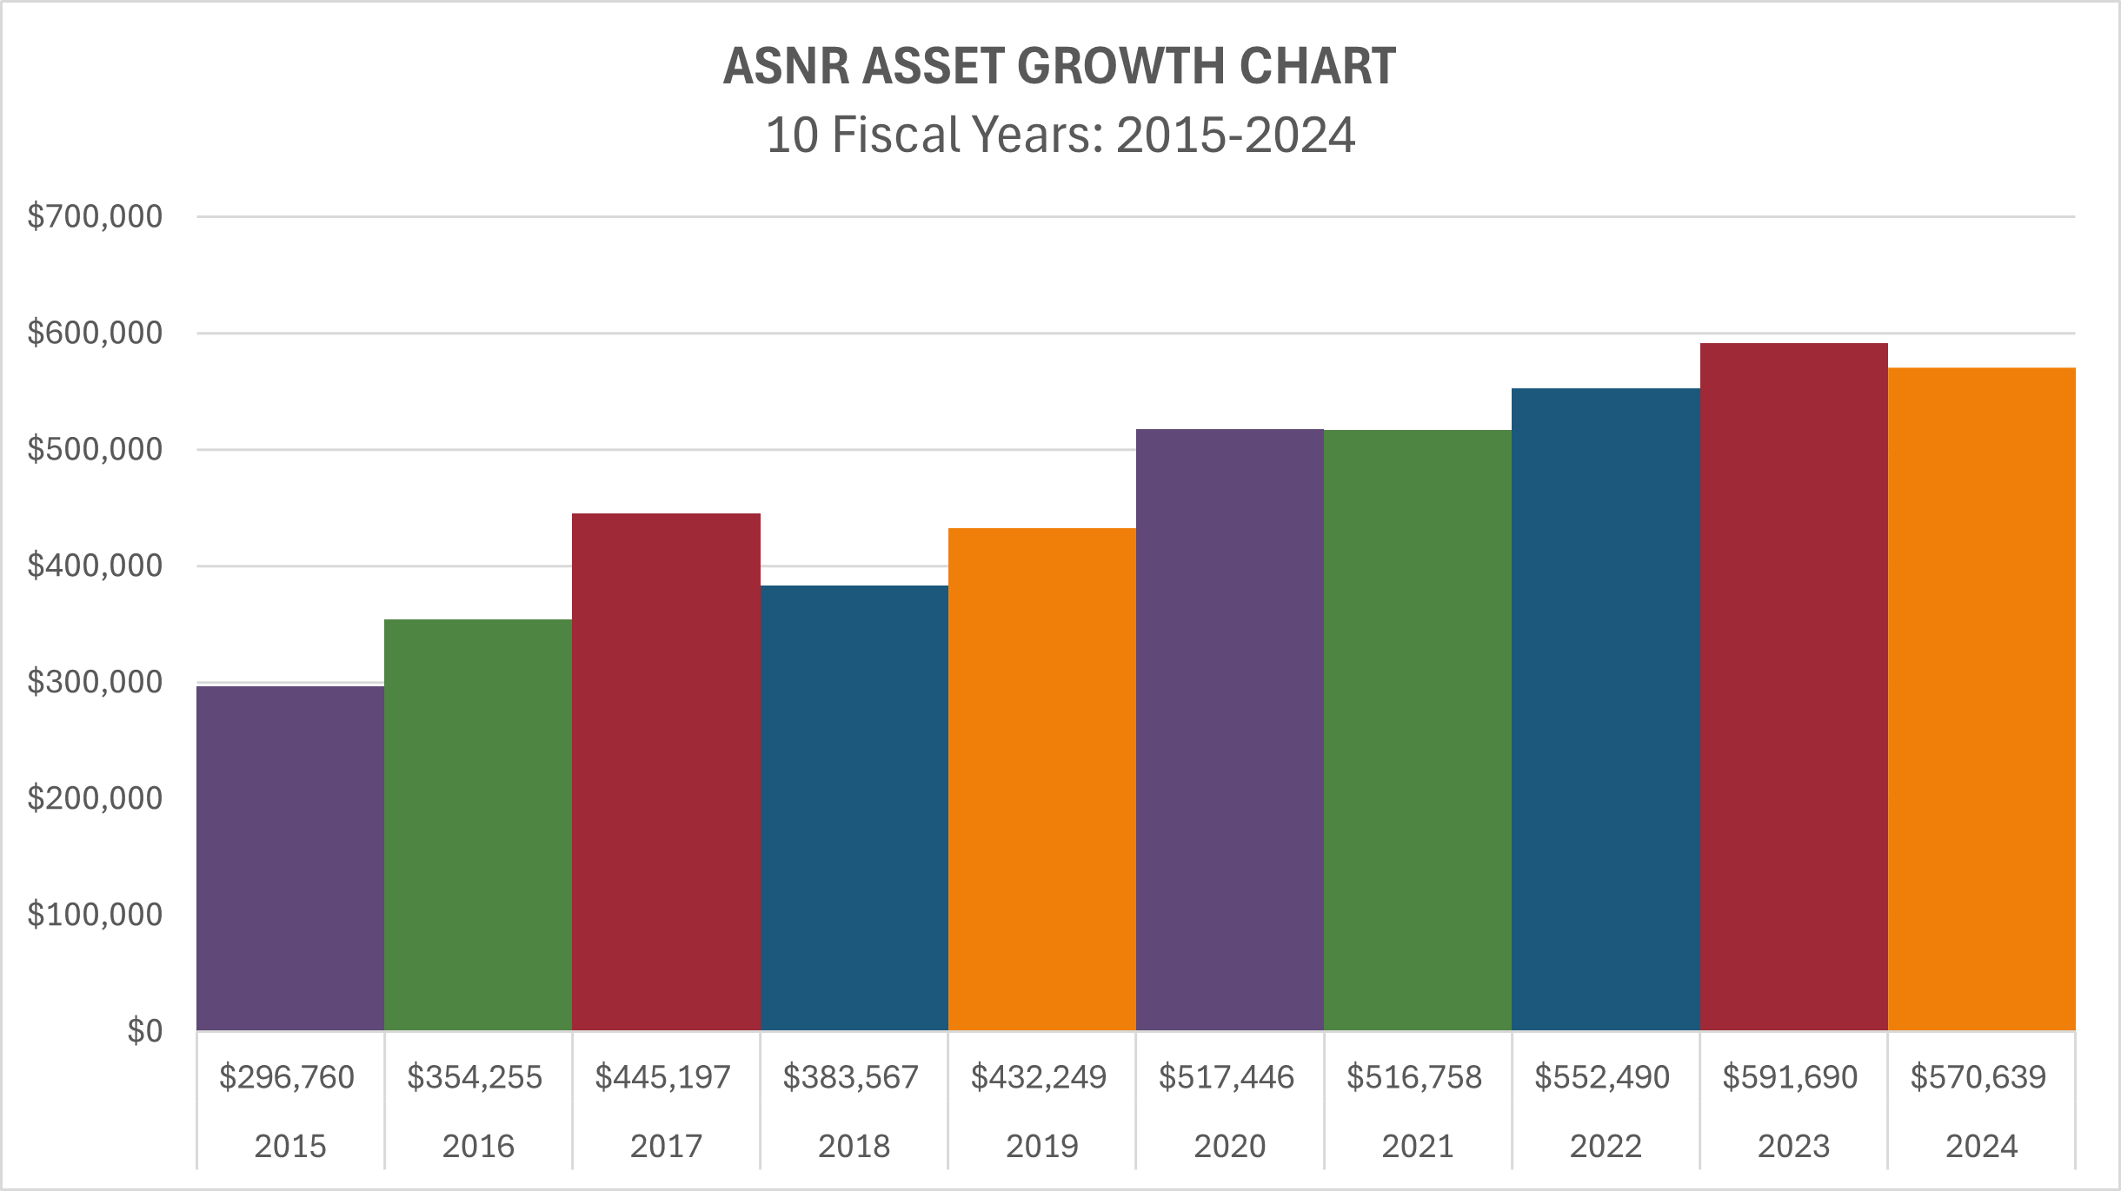
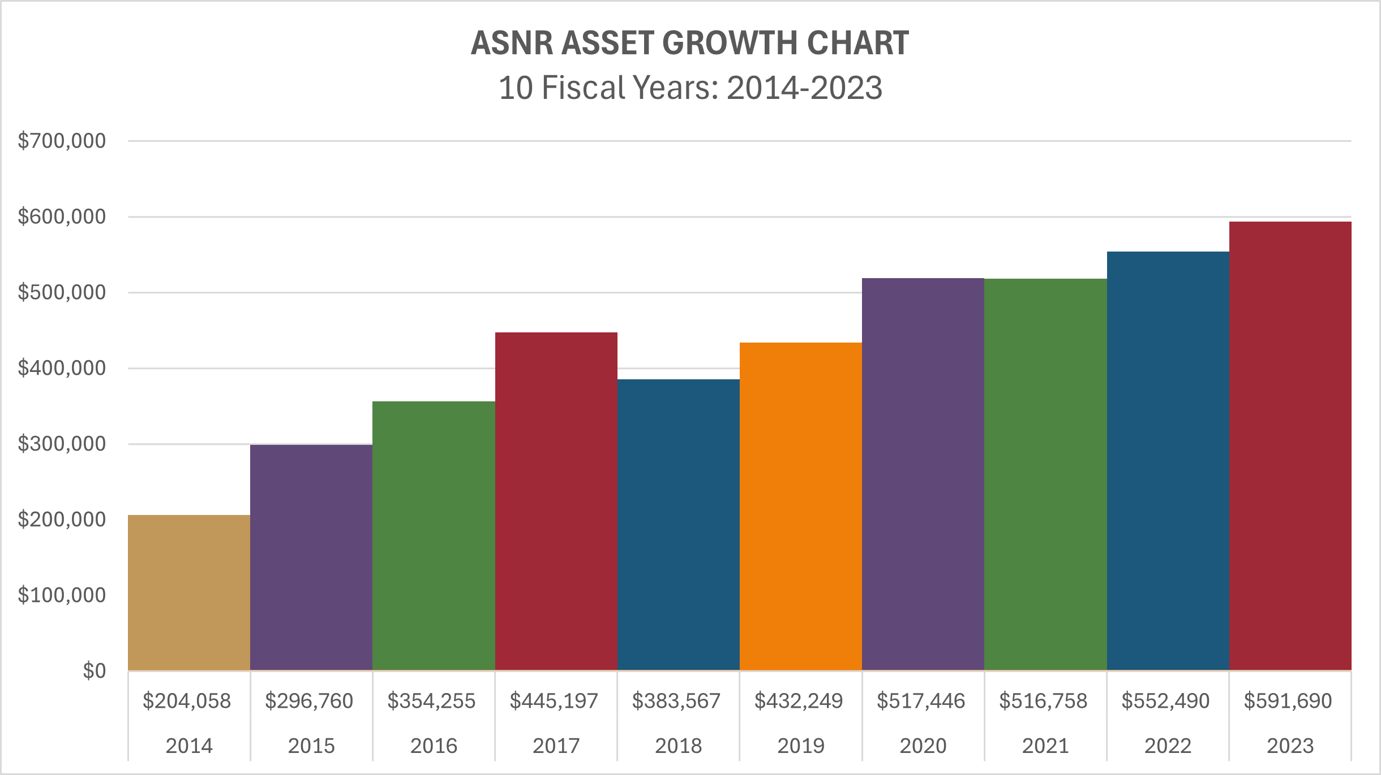

Slide 11
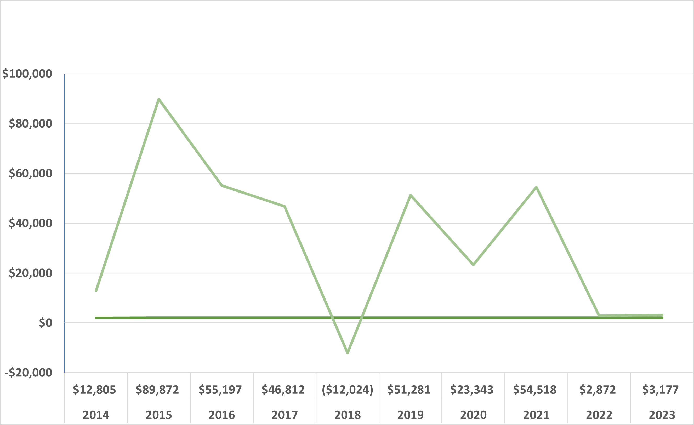
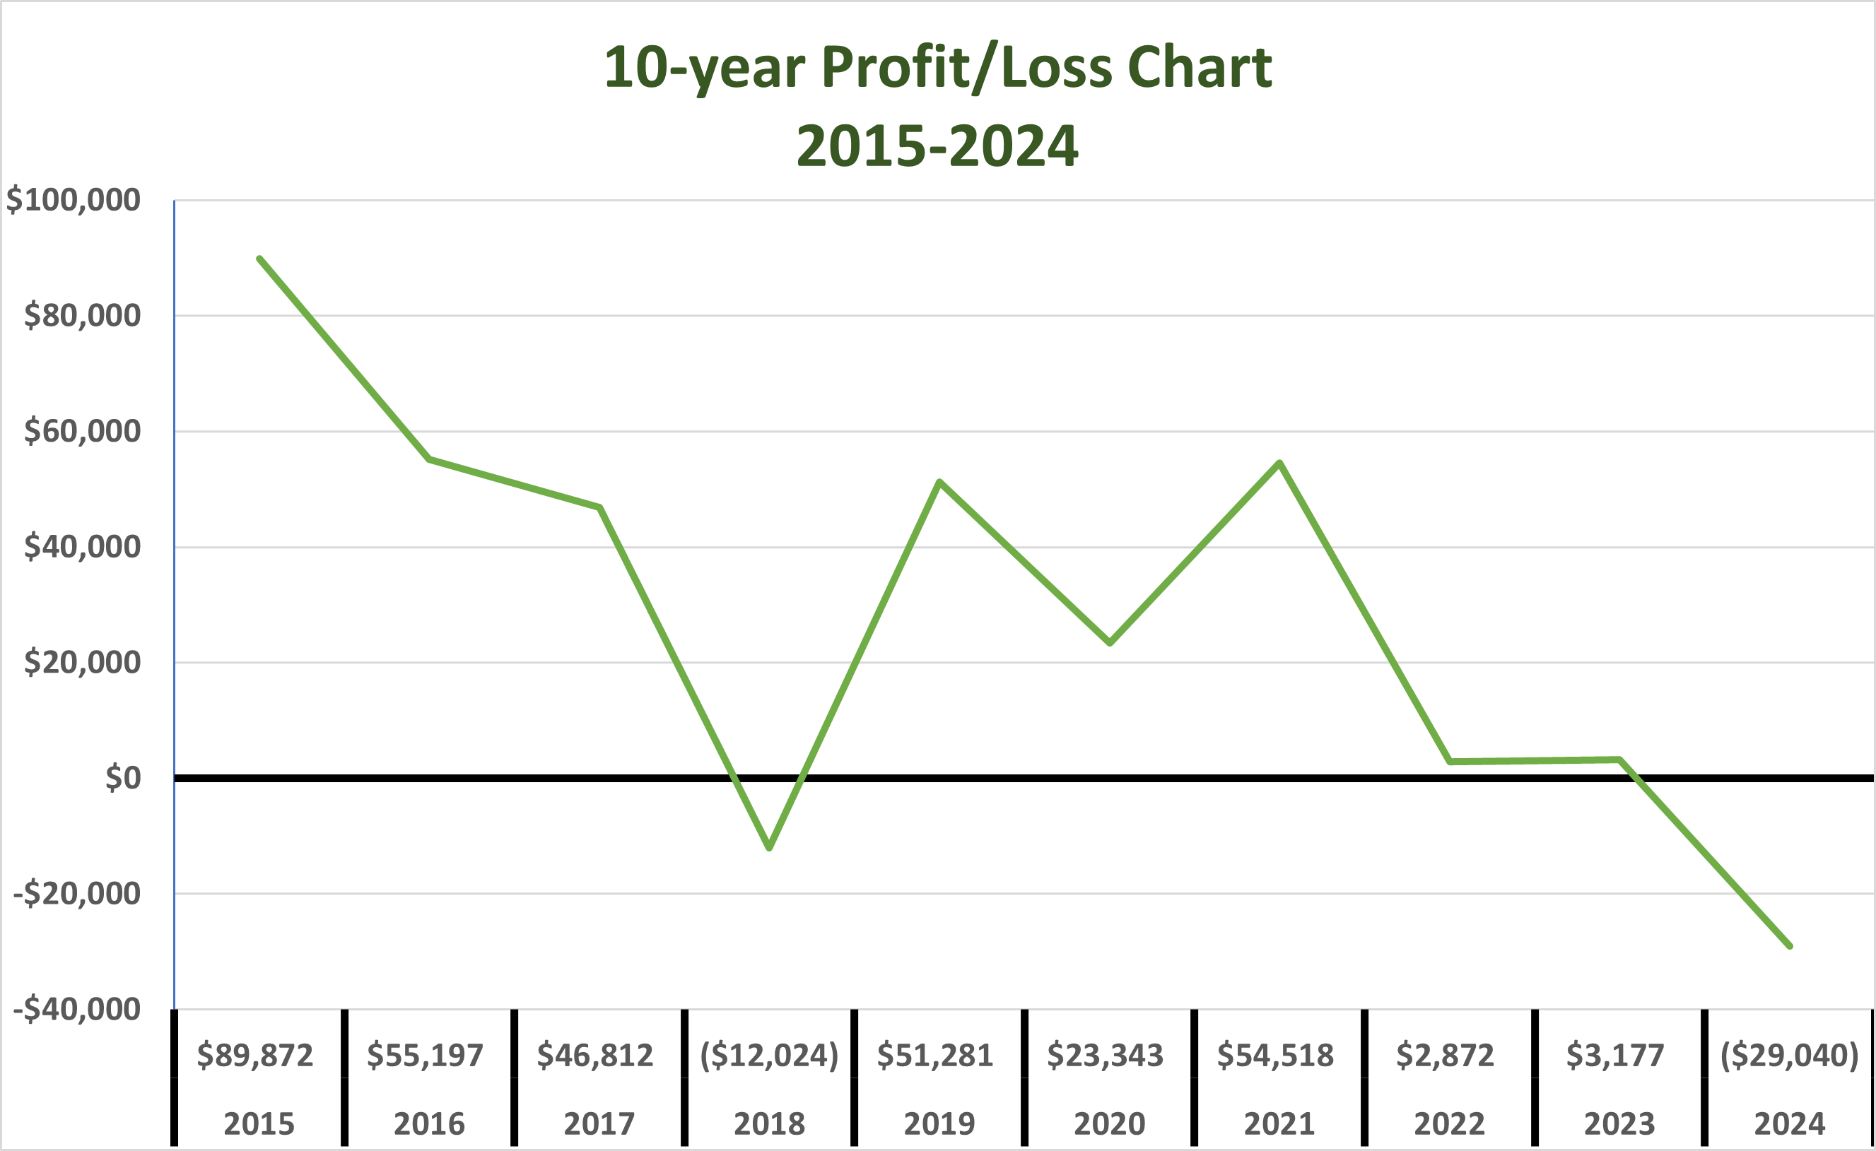
ASNR Summary of Annual Profits/Losses from 2014-2023
ASNR Summary of Annual Profits/Losses
from 2015-2024
Notes:
When creating your PowerPoint, please use ONLY the following:
Fonts: Gotham Black; Gotham Book
Colors: Black; Dark Blue: Hex: #194D7D; Light Blue: Hex: #A3B4CE; Gold: Hex: #FABD56

Slide 12
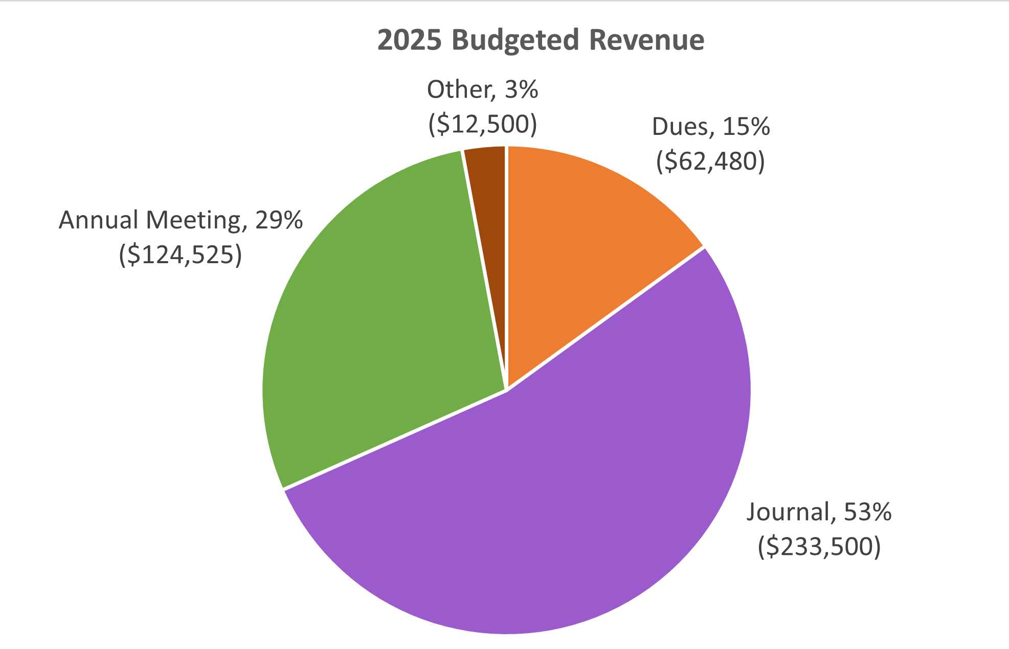
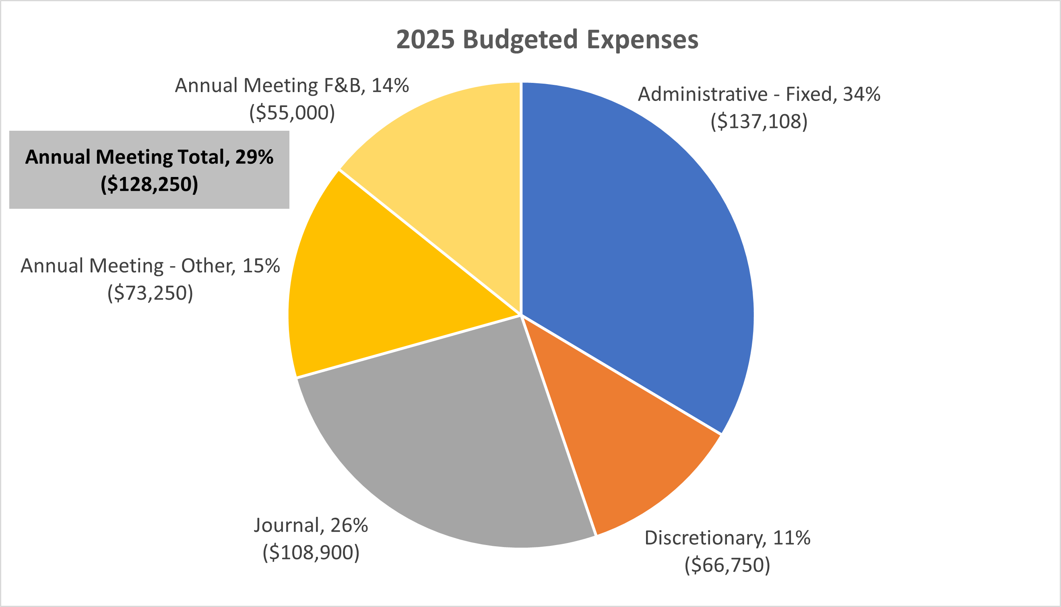

Slide 13
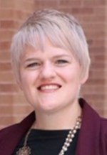
Program Committee Report
Kelsey Baker, PhD

Slide 14

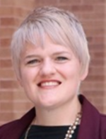
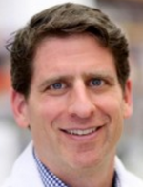
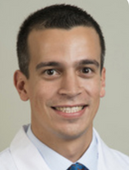
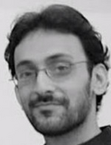
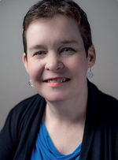
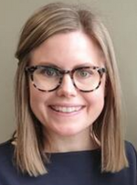
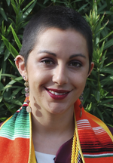
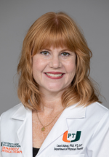
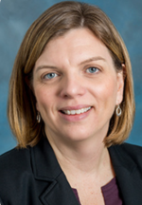
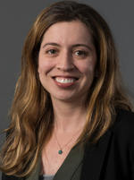
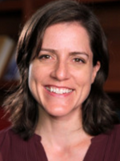
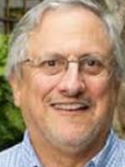
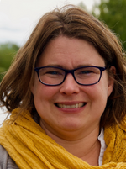
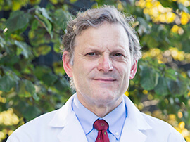
Program Committee
Kelsey Baker, PhD - Chair
Jason Carmel, MD, PhD
Ahmet Arac, MD
Naveed Ejaz, PhD
Kathleen Friel, PhD
Kate Hayward, PhD
Nicole Haikalis,
PhD Candidate
Lauri Bishop, PT, DPT, PhD
Welcome New Members:
Gottfried Schlaug
David Cunningham
Emily Grattan
Netta Gurari
Thank you Ahmet for your service!
Jill Stewart, PT, PhD
Natalia Sanchez, PhD
Heidi Schambra, MD
Rick Segal, PT, PhD, FAPTA
Charlotte Stagg, MRCP, DPhil
Steve Cramer, MD, MMSc, FAAN, FAHA

Slide 15





ASNR2025 Sponsors & Exhibitors

Slide 16
ASNR2025
273 Registered Attendees
Symposia Proposals
Symposia Submissions: 13
Symposia to be Presented: 7
Poster Abstracts
Poster Submissions: 170
Posters Accepted: 153
Posters To Be Presented: 145
Oral Abstracts: 6
*numbers as of April 17, 2025

Slide 17
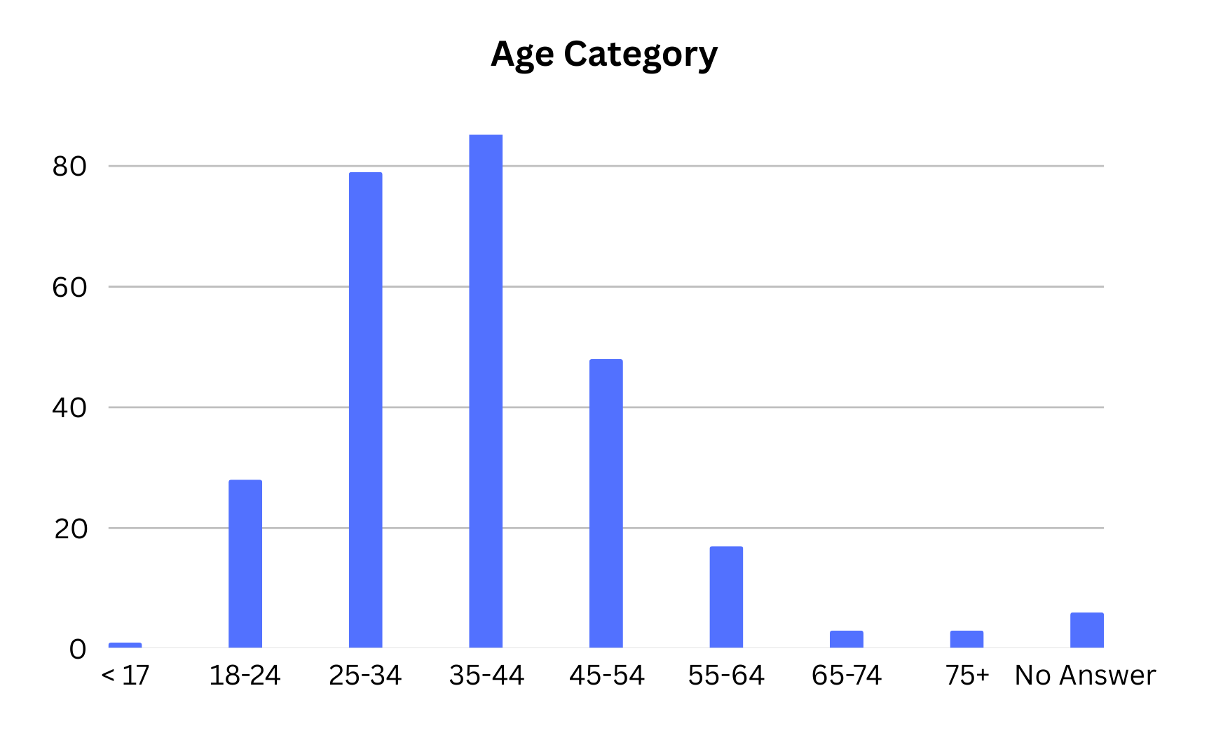
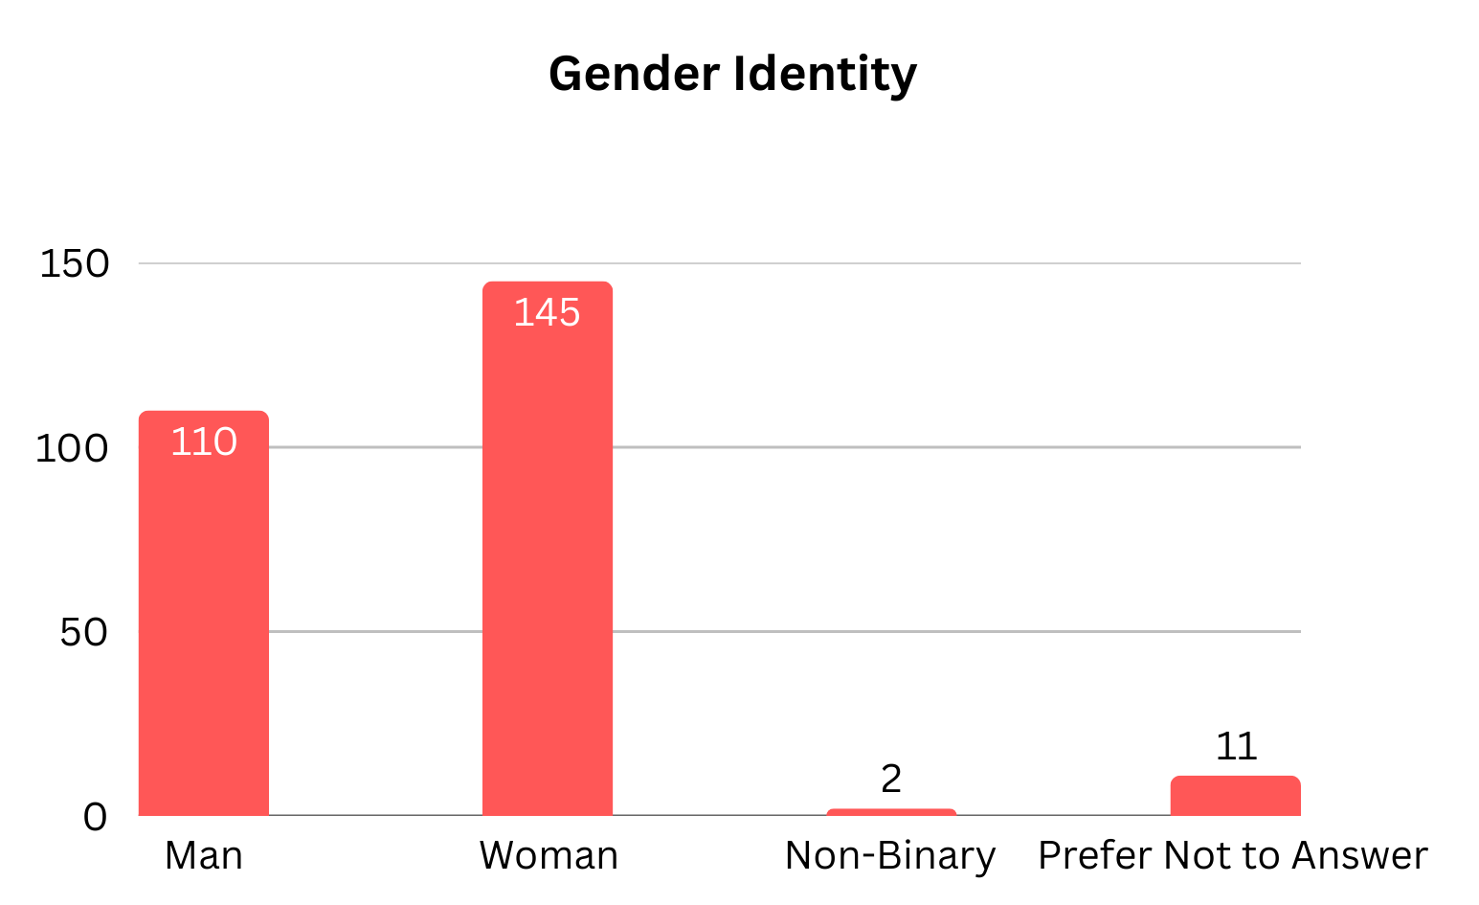
ASNR2025
DEMOGRAPHICS
*numbers as of April 17, 2025

Slide 18
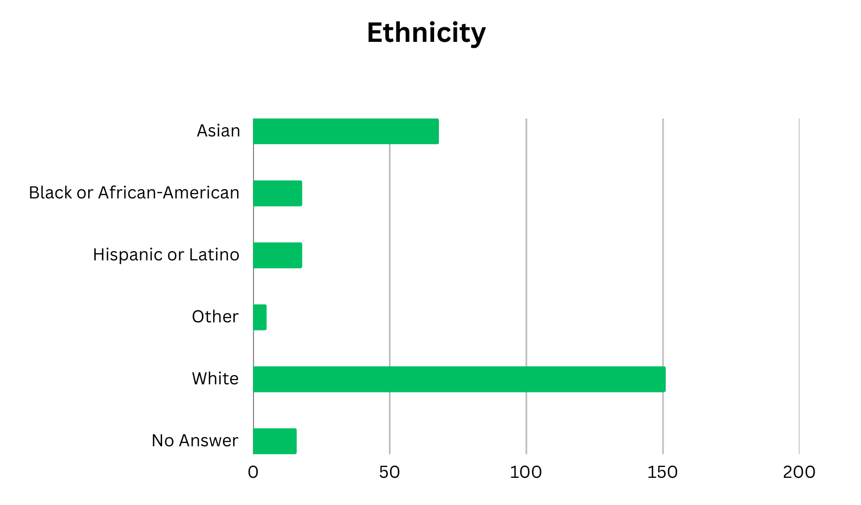
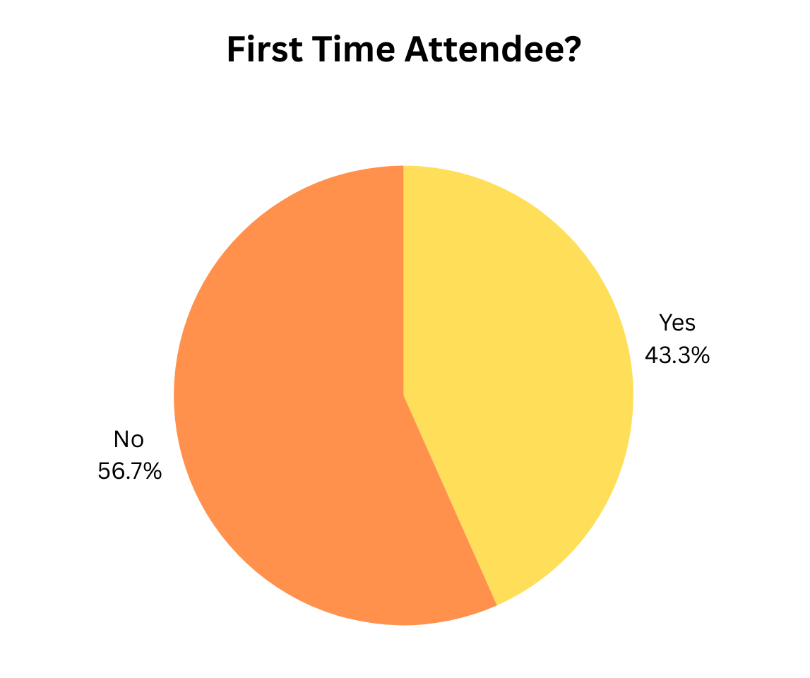
ASNR2025
DEMOGRAPHICS OF REGISTERED ATTENDEES
*numbers as of April 17, 2025

Slide 19
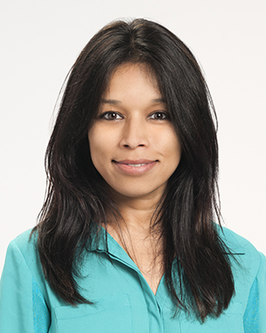
Education Committee Report Ela Plow, PT, PhD

Slide 20
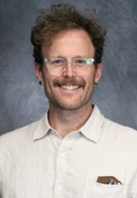
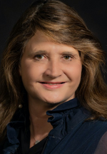
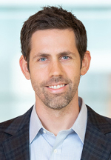
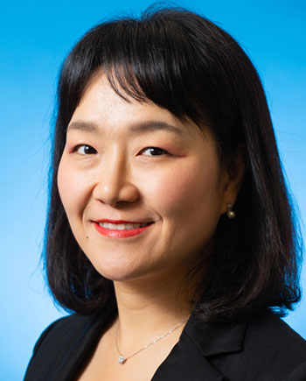
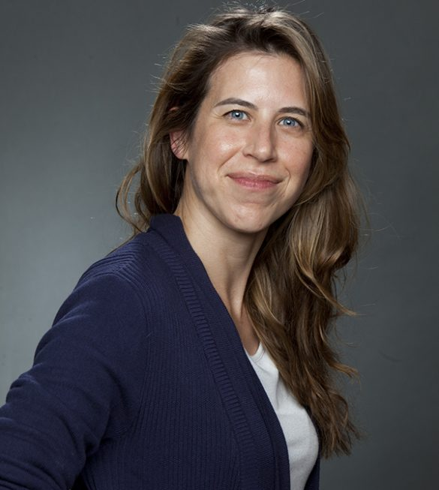
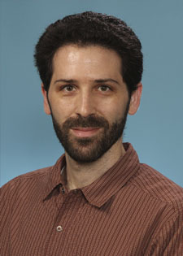
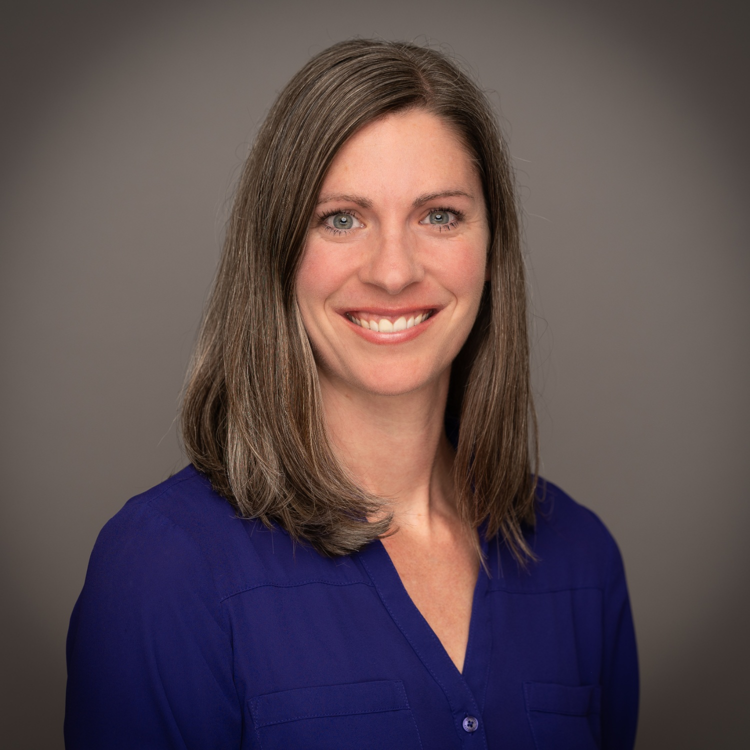

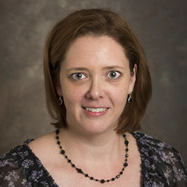
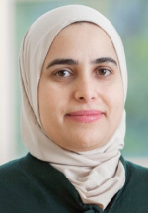
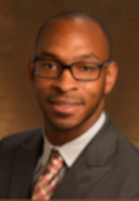
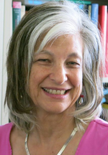
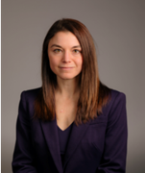
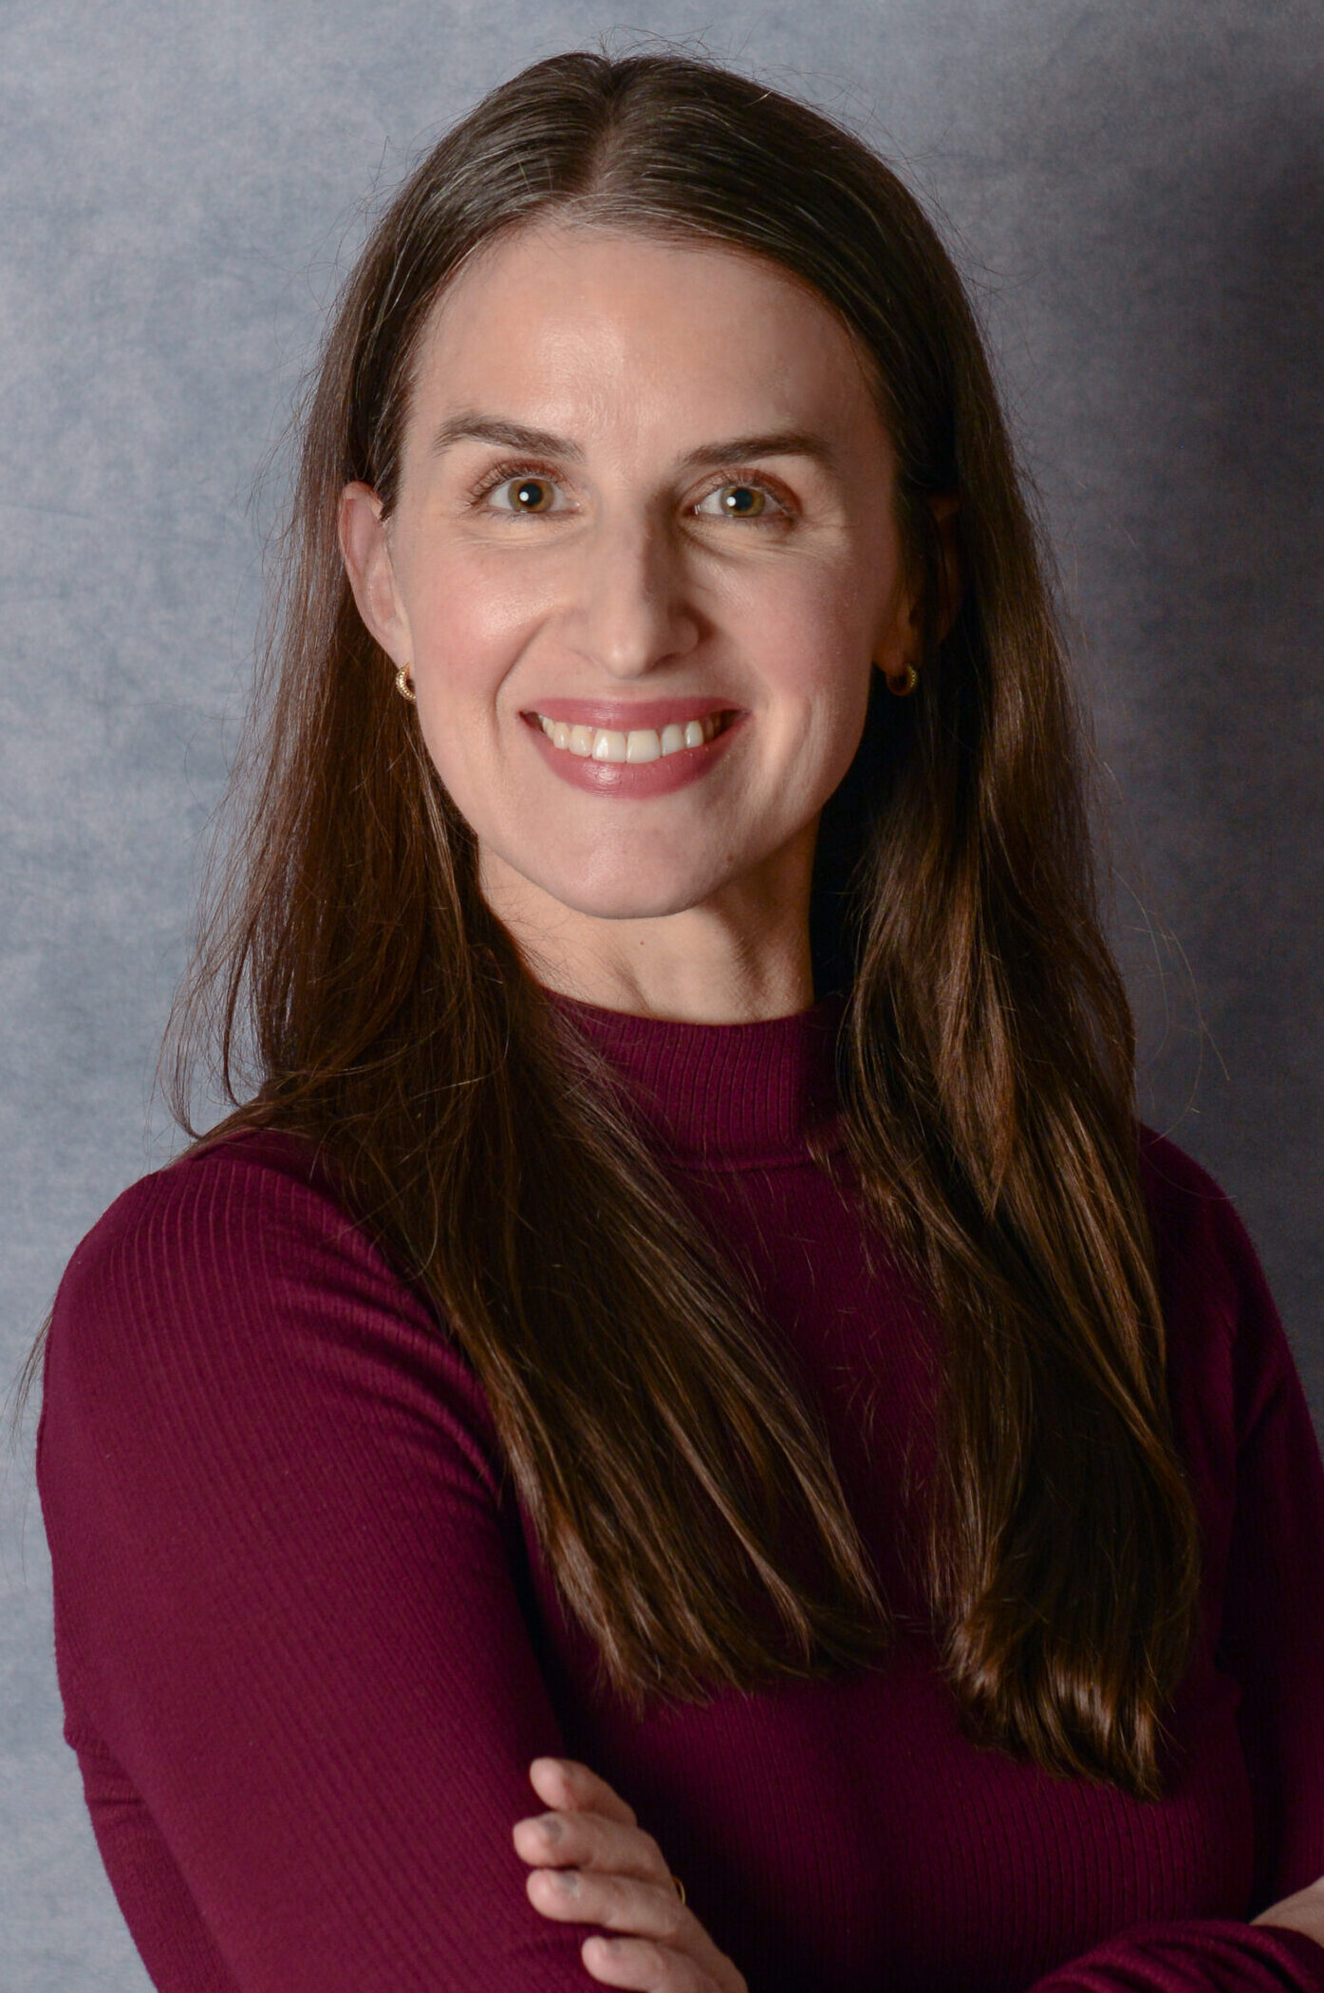
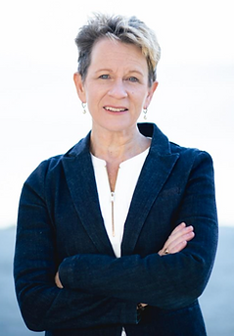
Thank You to the Education Committee
Keith Lohse, PhD, Pstat
Chair
Stephanie DeLuca, PhD
Seth Hays,
PhD
Jinsook Roh, PhD
Clarisa Martinez, PT, DPT, MS
Benjamin Philip, PhD
Maggie French,
PT, DPT, PhD
Ela Plow, PT, PhD
Susanne Morton, PhD, PT
Ahlam Salameh, PhD
Eric Espinoza-Wade, PhD
Carolee Winstein, PT, PhD, FAPTA, FAHA, FASNR
Jacqueline
Palmer,
PT, DPT, PhD
Jessica Cassidy,
PT, DPT, PhD
Michelle Ploughman,
PT, PhD

Slide 21
Education Committee
Education Committee Mission
Serve the professional and technical development of neurorehabilitation researchers across the career spectrum, with an emphasis on trainees and early-career faculty
Develop educational sessions & materials to be provided online and @ the Annual Meeting
Develop in-person and virtual mentoring opportunities
Promote professional development opportunities offered by related organizations

Slide 22
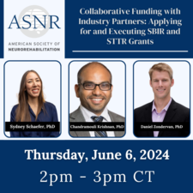


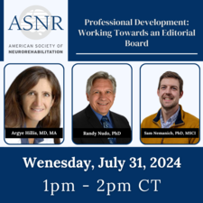
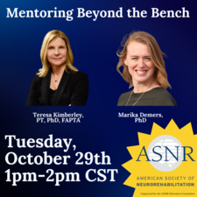
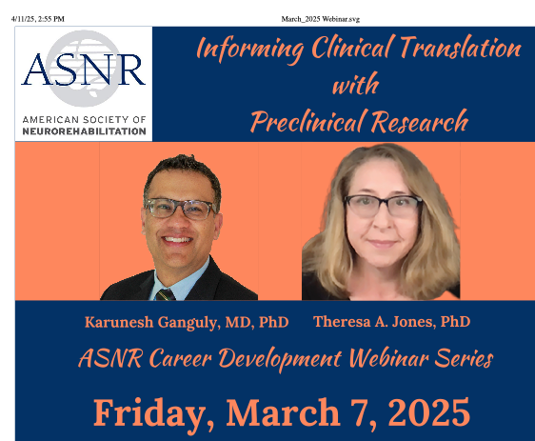
Education Committee Initiatives
1. Webinars- Every 2 months

Slide 23
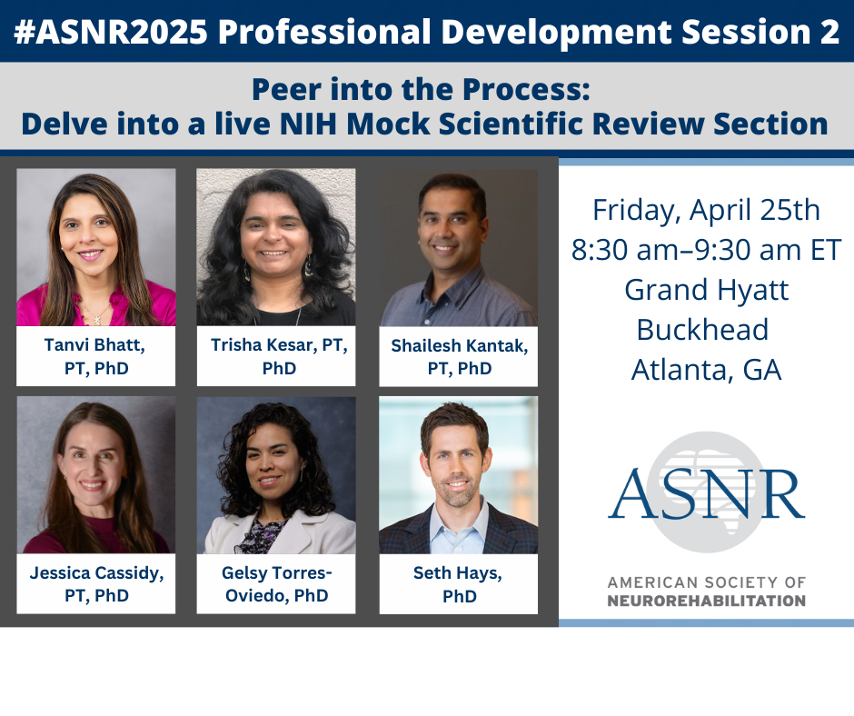

Education Committee Initiatives
2. Professional Development Symposia @ Annual Meeting
Jacqueline
Palmer,
PT, DPT, PhD
Maggie French,
PT, DPT, PhD
Clarisa Martinez, PT, DPT, MS

Slide 24






Education Committee Initiatives
3. Professional Development Roundtables @ Annual Meeting

Slide 25










Education Committee Initiatives
4. ASNR’s TIGRR Awards
2024
2022
Carolee Winstein, PT, PhD, FAPTA, FAHA, FASNR
Ahlam Salameh, PhD
Ahlam Salameh, PhD
Brice Cleland,
PhD
Sam Nemanich,
PhD, MSCI
Marika
Demers
PhD
Jacqueline
Palmer,
PT, DPT, PhD
Maggie French,
PT, DPT, PhD
Swati Sukar,
PT, PhD
2023
2025
Jia Liu
Andrew Hooyman
Kimberly Waddell
Rachael Harrington, PhD, CCC-SLP
Netta Gurari,
PhD
Karen Chenausky, PhD, CCC-SLP

Slide 26
























Education Committee Initiatives
2025 Virtual Mentoring Cohort 5
Charalambos Charalambous, PhD
- Mentor
Namarta Kapil,
PhD
- Mentee
Marika Demers,
PhD
- Mentor
Samah Gassass,
PhD Student
- Mentee
Susanne Morton, PT, DPT
- Mentor
Jessica Bath
DPT, PhD
- Mentee
Charlotte Stagg,
PhD
- Mentor
Syed Qadri,
MD
- Mentee
Steven C. Cramer, MD
- Mentor
Anna Greenwald, PhD
- Mentee
Michael Ellis,
PT, DPT
- Mentor
Shraddha
Srivastava, PT, PhD
- Mentee
Svetlana Pundik,
MD, MSc
- Mentor
Chang Liu,
PhD
- Mentee
Jill Stewart,
PT, PhD
- Mentor
Cristian Cuadra,
PhD
- Mentee
David Cunningham, PhD
- Mentor
Abed Khorasani, PhD
- Mentee
Jyutika Mehta,
PhD, CCC-SLP
- Mentor
Heidi Benson Rodriguez, MS
- Mentee
Ryan Roemmich,
PhD
- Mentor
Andrian Kuch,
PhD
- Mentee
Steven Wolf,
PhD
- Mentor
Uttara Kahatri,
PhD Student
- Mentee

Slide 27


Education Committee
2026 Virtual Mentoring Cohort 6
Want to be a Mentee or Mentor in next year’s cohort?
You can apply today!
Visit ASNR.com to apply for next year’s Virtual Mentoring Program!

Slide 28

Membership Engagement Committee Report
Steven R. Zeiler, M.D., Ph.D

Slide 29













Membership Engagement Committee

Slide 30


Slide 31
Membership Engagement Committee
2022-2025 GOALS UPDATES
GOALS | PROGRESS
Increase total membership by 10% over a rolling 3-year average. | Continuing to achieve Using a cross-pollination strategy to like-minded societeis Strong word-of mouth advertising Social media presence
Characterize the demographic profile of our members, for the larger purpose of setting realistic, measurable goals related to membership drives, intersection with core strategies, and Diversity, Equity, & Inclusion (DEI). | Continuing to analyze data from the revised membership application form Continuing to analyze data from the revised meeting registration forms
Determine the key, reproducible mechanisms through which ASNR gains members. | Conference is driving factor to renew Physician outreach brainstorming DEI
Align the goals & plans for the ASNR Membership Engagement Committee with the overall ASNR Strategic initiatives, including DEI. | We have confirmed common language, goals. This committee will provide key data for the organization Using the talents and passion of the Membership Committee members to achieve goals.

Slide 32
Membership Engagement Committee
2022-2025 GOALS UPDATES
GOALS | PROGRESS
Increase total membership by 10% over a rolling 3-year average. | Continuing to achieve Using a cross-pollination strategy to like-minded societeis Strong word-of mouth advertising Social media presence
Characterize the demographic profile of our members, for the larger purpose of setting realistic, measurable goals related to membership drives, intersection with core strategies, and Diversity, Equity, & Inclusion (DEI). | Continuing to analyze data from the revised membership application form Continuing to analyze data from the revised meeting registration forms
Determine the key, reproducible mechanisms through which ASNR gains members. | Conference is driving factor to renew Physician outreach brainstorming DEI
Align the goals & plans for the ASNR Membership Engagement Committee with the overall ASNR Strategic initiatives, including DEI. | We have confirmed common language, goals. This committee will provide key data for the organization Using the talents and passion of the Membership Committee members to achieve goals.

Slide 33
Membership Engagement Committee
MEMBERSHIP DEMOGRAPHIC
Increase total membership by 10%, over the rolling 3-year average.

Slide 34


Membership Engagement Committee
Continuing Partnership with Unfold Productions
SOCIAL MEDIA ENGAGEMENT
ASNR ONLINE PRESENCE
ASNR MEMBERSHIP

Slide 35








Membership Engagement Committee
Partnering Societies
Notes:
VISION
Neurorecovery through discovery
MISSION
To improve the lives of people with neurological disorders through advances in basic and clinical research
VALUES
High Quality Science
We value rigorous and evidence-based science.
Diversity and Inclusivity
We value differences in ideas and embrace people from all backgrounds
Interdisciplinary
We value the exchange of ideas among all scientists and professionals in neurorecovery.
Leadership
We strive to provide leadership in the science, technology, and best clinical practices of neurorecovery.
Education
We value mentorship and training of the next generation of scientists and clinicians.

Slide 36








Membership Benefits
Neurorehabilitation & Neural Repair (ASNR's Journal), complimentary subscription
Webinar Series, receive access to live & on-demand content
Annual Meeting reduced fees
Virtual Mentoring Program - networking opportunities w/ other neurorehab professionals
Leadership Committees provide opportunities to serve

Slide 37
Membership Engagement Committee
2022-2025 GOALS UPDATES
GOALS | PROGRESS
Increase total membership by 10% over a rolling 3-year average. | Continuing to achieve Using a cross-pollination strategy to like-minded societeis Strong word-of mouth advertising Social media presence
Characterize the demographic profile of our members, for the larger purpose of setting realistic, measurable goals related to membership drives, intersection with core strategies, and Diversity, Equity, & Inclusion (DEI). | Continuing to analyze data from the revised membership application form Continuing to analyze data from the revised meeting registration forms
Determine the key, reproducible mechanisms through which ASNR gains members. | Conference is driving factor to renew Physician outreach brainstorming DEI
Align the goals & plans for the ASNR Membership Engagement Committee with the overall ASNR Strategic initiatives, including DEI. | We have confirmed common language, goals. This committee will provide key data for the organization Using the talents and passion of the Membership Committee members to achieve goals.

Slide 38


Gender
2023
2024
n= 93
n= 66

Slide 39




Age
2023
2024

Slide 40




Career Stage
2023
2024

Slide 41





Race / Ethnicity
2023
2024

Slide 42


Members from underrepresented backgrounds
2023
2024
N=47
N=88

Slide 43
Membership Engagement Committee
2022-2025 GOALS UPDATES
GOALS | PROGRESS
Increase total membership by 10% over a rolling 3-year average. | Continuing to achieve Using a cross-pollination strategy to like-minded societeis Strong word-of mouth advertising Social media presence
Characterize the demographic profile of our members, for the larger purpose of setting realistic, measurable goals related to membership drives, intersection with core strategies, and Diversity, Equity, & Inclusion (DEI). | Continuing to analyze data from the revised membership application form Continuing to analyze data from the revised meeting registration forms
Determine the key, reproducible mechanisms through which ASNR gains members. | Conference is driving factor to renew Physician outreach brainstorming DEI
Align the goals & plans for the ASNR Membership Engagement Committee with the overall ASNR Strategic initiatives, including DEI. | We have confirmed common language, goals. This committee will provide key data for the organization Using the talents and passion of the Membership Committee members to achieve goals.

Slide 44
Membership Engagement Committee
2022-2025 GOALS UPDATES
GOALS | PROGRESS
Increase total membership by 10% over a rolling 3-year average. | Continuing to achieve Using a cross-pollination strategy to like-minded societeis Strong word-of mouth advertising Social media presence
Characterize the demographic profile of our members, for the larger purpose of setting realistic, measurable goals related to membership drives, intersection with core strategies, and Diversity, Equity, & Inclusion (DEI). | Continuing to analyze data from the revised membership application form Continuing to analyze data from the revised meeting registration forms
Determine the key, reproducible mechanisms through which ASNR gains members. | Conference is driving factor to renew Physician outreach brainstorming DEI
Align the goals & plans for the ASNR Membership Engagement Committee with the overall ASNR Strategic initiatives, including DEI. | We have confirmed common language, goals. This committee will provide key data for the organization Using the talents and passion of the Membership Committee members to achieve goals.

Slide 46
SPECIAL THANK YOU
ATLANTA SCIENTISTS
NEW MEMBERS

Slide 47

NNR Journal Report
Randy Nudo, PhD

Slide 48

Editor’s Report
to the ASNR Board
April 2025
Randolph J. Nudo, PhD, Editor-in Chief
Alyssa Venezia, Publishing Editor
Gert Kwakkel, PhD, European Managing Editor
Deborah Barton, Editorial Manager

Slide 49
Key Successes for 2024
29% increase in submissions
Improved time to first decision
Early Career Editor Program

Slide 50


Slide 51


Slide 52


Slide 53


Slide 54


Slide 55


Slide 56


Slide 57



Slide 58


Slide 59


Slide 60


Early Career Editor Program
Sam Nemanich, PhD, MSCI
Assistant Professor
Department of Occupational Therapy
Marquette University
Daniele Piscitelli, PT, PhD
Assistant Professor
Department of Kinesiology
University of Connecticut
Natalia Sánchez, PhD
Assistant Professor
Department of Physical Therapy
Chapman University

Slide 61
Focus Areas
Editorial Board Members
Peer Reviewers
Authors
1
2
3

Slide 62
Thanks! Questions?

Slide 63
Spring 2025 Election Results
Catherine Lang, PT, PhD, FASNR

Slide 64



New ASNR Board of Directors Member
President:
Lewis Wheaton, PhD
Vice President:
Jason Carmel, MD, PhD
New ASNR Officers
Secretary/Treasurer:
Kelsey Baker, PhD
Michelle Johnson, PhD
Past President:
Catherine Lang, PT, PhD, FASNR
University of Pennsylvania

Slide 65
Special Thank You
Catherine Lang, PT, PhD, FASNR

Slide 66

Tom Carmichael
Program Chair: 2014-2016
Secretary/Treasurer: 2016-2018
Vice President: 2018-2021
President: 2021-2023
Past President: 2023-2025

Slide 67
Additional Business
Catherine Lang, PT, PhD, FASNR

Slide 68

To view this slideshow, visit www.asnr.com/business-meeting or scan the QR code.

Slide 69
THANK YOU & ADJOURN

